Slide 1

Projects Using React.js & Flux
Project 5: ContactList

Slide 2
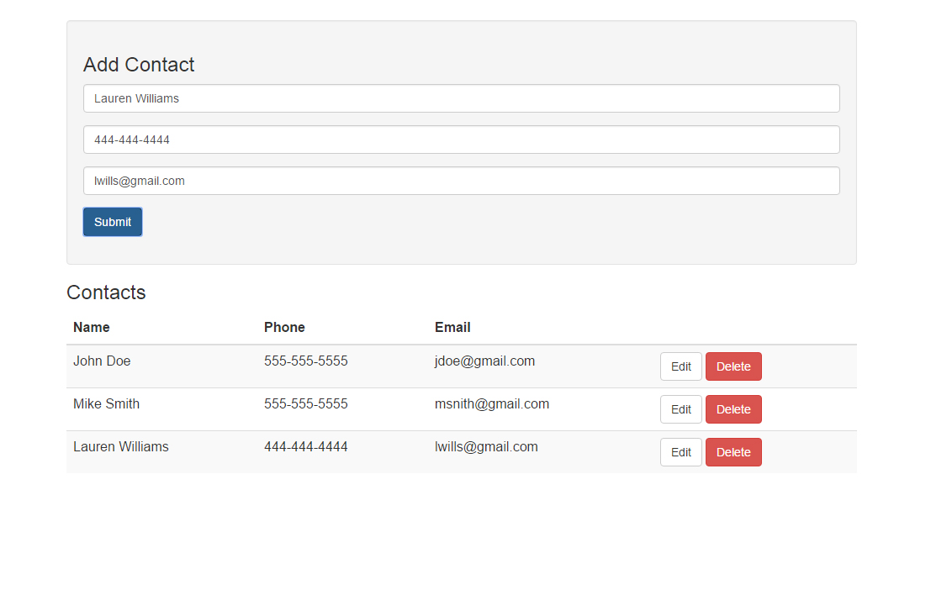
Project Description
An application that allows you to add, update and delete contacts and persist data to Firebase

Slide 3
Project Lectures
Section Intro
Flux Boilerplate Setup
Adding Contacts to Store
Listing & Deleting Contacts
Edit & Update Contacts

Slide 4
What You Will Learn
How to add & remove data from Firebase & store
How to edit & delete data from Firebase & store
Work with more advanced state & prop data

